Slide 1
Alternate Project Delivery Systems for Governments

Slide 2
Preliminaries
Safety, exits
Comfort
Lunch, ASCE meeting
Certificates and Evaluations
No, Evaluations and Certificates

Slide 3
Thanks
Trish Main and AGC
ASCE and employers
UAF Student ASCE
Moolin Family

Slide 4
Program
Agenda
  Note breaks
  Discussions at end
Speaker bio-sketches
ASCE Officers
UAF Students
Three-ring Binder - not

Slide 5
Warm-up
Alternate Project Delivery Systems for Governments

Slide 6
Project
Need
Funding (“programing, “planning,” other)
Design
Construction
O&M
Demolition

Slide 7
Project Delivery System
Defines the relationships, roles, and responsibilities of the project team and sequence of activities required.
Incudes Procurement Methods
  Contract type
  Contractor selection

Slide 8
Project
Need
Funding (“programing, “planning,” other)
Design
Construction
O&M
Demolition

Slide 9
Contacting Methods
Lump sum
Cost plus
Cost reimbursable
“T&M”
“In house”

Slide 10
Contractor Selection
CSB, Completive Sealed Bids
Regulations always say “qualified”
Define?
  Bonding
Other?
  QBS
  “Best Value”

Slide 11
“Governments”
Different?

Slide 12
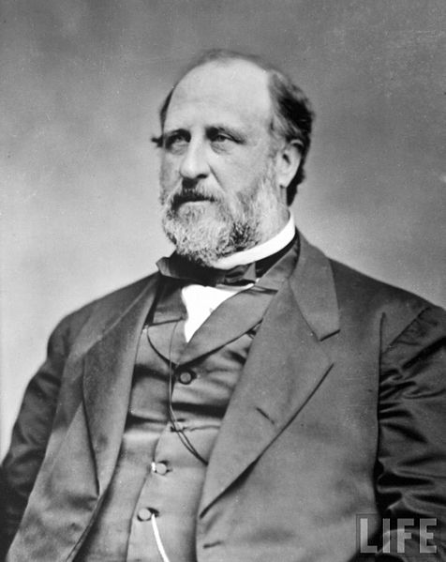
Boss Tweed

Slide 13
Mid 19 Century
US House of Representative, NY State Senator
Controlled NY City
Stole between 25 and 200 million in 1870 dollars, or about
$1 to $8 billion is todays dollars.

Slide 14
Tweed’s Project Delivery System
Public had need, such a new hospital
“Entrepreneur” recognizes need and went to Tweed or his agent
Entrepreneur agrees to hire “contractors” designated by Tweed
Contractors agree to pay Tweed or his agents when they get the job

Slide 15
Tweed gets appropriation for hospital
Government hires contractors designed by Tweed
Hospital gets built
All bad?
Tweed and hundreds of others like him led to a plethora of laws governing public construction.

Slide 16
Public Construction Contracts
Federal
  CFRs
  41CFR
  FARs
State
  Title 36
Local

Slide 17
Public Contract
Public Confidence Goal (anti-corruption goal)
  Procurement
    accountability, transparency, equity and fair dealing
Public Welfare Goal

Slide 18
“Alternate”
Wars
  Start with complex regulations
  Government can’t process the paperwork
  Not enough contractors anyhow
  Evolve into expedited methods
  Cost reimbursable common

Slide 19
Owner’s Constraints
Laws
  Federal
  State
  Local
Rules
  Corporate
  PUB
  NGO
Specify details of process?

Slide 20
QBS
Qualifications Based Selection
AS 36.30.270
  ….procurement officer shall negotiate a contract for an agency with the most qualified and suitable firm or person of demonstrated competence for architectural, engineering, or land surveying services.
Negotiations with most qualified
  All model procurement codes and federal

Slide 21
Project Delivery System
Design-bid-build
  A/E Design
    QBS
  Qualifications
    Bonding
    Other
  Best Value
    Not quite QBS

Slide 22
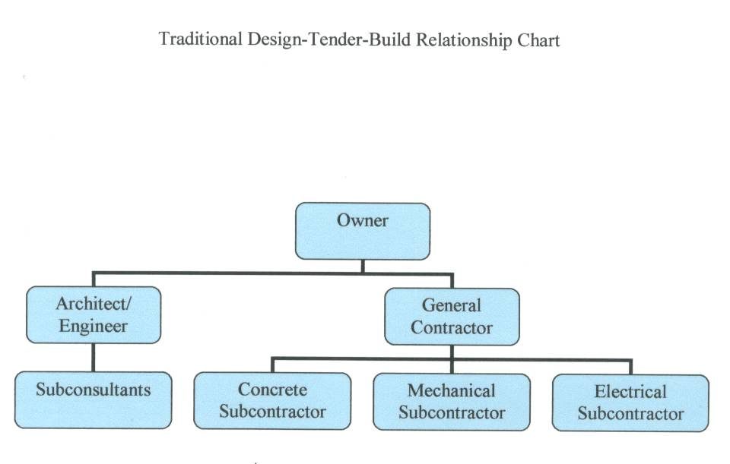
Design-Bid-Build, AKA “traditional” or “low bid”

Slide 23
Design-Bid-Build, AKA “traditional” “low bid”
Determines need, finds $
QBS

Slide 24
Design-Build
Design-build
  QBS
  Technical
  Cost

Slide 25
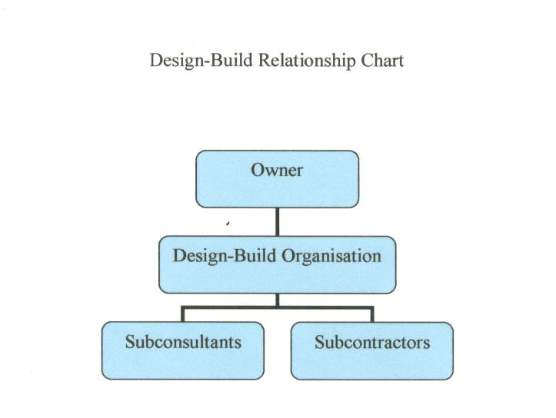

Slide 26
QBS

Slide 27
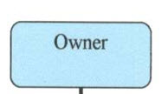
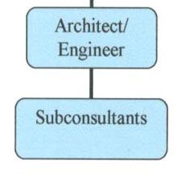
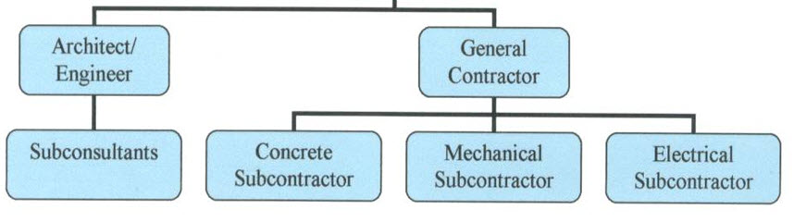
CMAR, GC/CM
Start with CM not at risk
CM, consultant

Slide 28
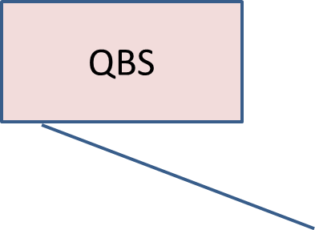
CMAR, GC/CM
CM, consultant

Slide 29
What the hell is CMAR?
Construction Manager at Risk
AKA GC/CM, General Contractor Construction Manager
Owner employs the A/E.
(Contrast with CM as agent)
Notes:
Most governmental CMR contracts have these features: The CM is selected based on chiefly or entirely on qualifications. The owner employs the A/E. The CM works with the owner and the A/E during the design phase providing “preconstruction services:” evaluating costs, estimating, providing value analysis, scheduling, and constructability advice. The owner pays for these preconstruction services separately from the construction services. If there are long lead procurements or certain construction items that must be fast-tracked, these are also paid separately during this preconstruction phase. As the design nears completion, the owner and the CM negotiate a price or fee for the project. This might be a lump sum price or a cost reimbursable contract with a fixed fee. If the owner and CM cannot agree on the price, the CM is paid for the preconstruction services and the owner will seek a different contractor for construction. A common fee arrangement is a “Guaranteed Maximum Price” (GMP). The CMR will subcontract all or most of the work. If the final cost is less than the GMP, the CM and the owner may split the savings by a pre-agreed formula.

Slide 30
Owner hires A/E, who reports to owner
CM is selected based on qualifications
  QBS
The CM provides “preconstruction services:” evaluating costs, estimating, providing value analysis, scheduling, and constructability advice
Owner and CM negotiate a price at about 95% design
“Guaranteed Maximum Price” (GMP)

Slide 31
Other
Job Order Contracting
  Many large utilities
  Chiefly O&M
Public Private Partnerships

Slide 32
Public-private partnerships (PPP)
AKA: build, operate, transfer (BOT), build, own, operate, transfer (BOOT) design, build, finance, operate (DBFO)
Three possible kinds of arrangements within the definition of PPP:
  Financially free-standing projects – all costs for project will be charged to end users, such as toll roads, bridges.
  Services sold to private sector – costs for project are covered through charges for the services to be paid upon their deliveries as in the case of schools, student accommodations, hospitals, prisons.
  Joint ventures – project costs are recovered partly from end-users and partly though subsidies from public funds.[3]

Slide 33
Discussions
Rural, QC, Claims
Personal experiences
Other points of view
Master’s Project
Web site

